Slide 1

2024
Conrad Challenge
Spiderderm
Foaming Patch
for Burn Patients
Using Spider Silk

Slide 2
01 /
Our Idea
02 /
Burn = Pain
Conrad
Challenge
03 /
Our Project
CONTNTS
04 /
Our Customer
05 /
Misc.

Slide 3


01
PART
Our Idea
This work focused on reducing the pain of burn patients
and began with pain relief as the most important factor.
Spider Silk
Foaming Type
Less Pain
Easy Application

Slide 4
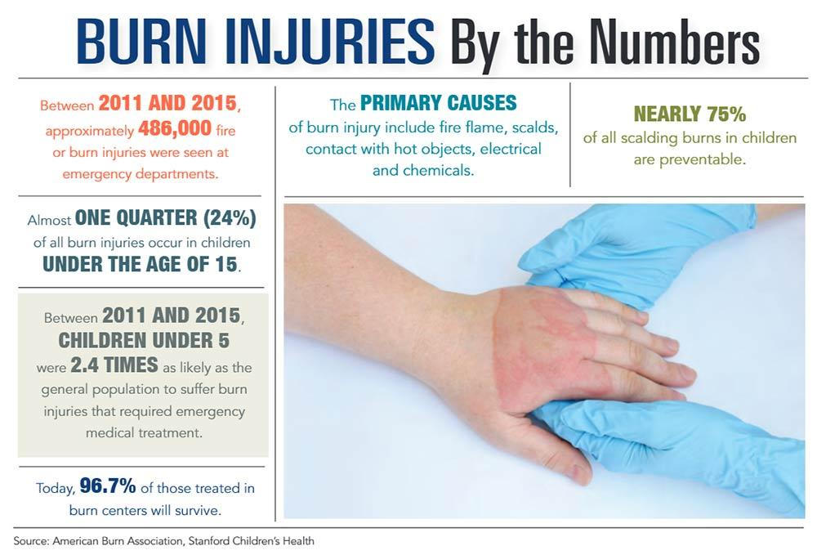
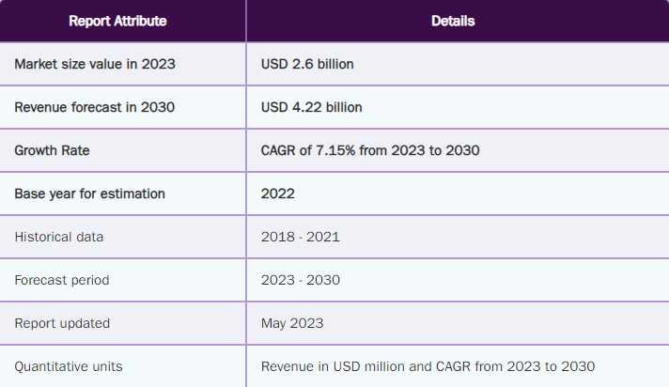
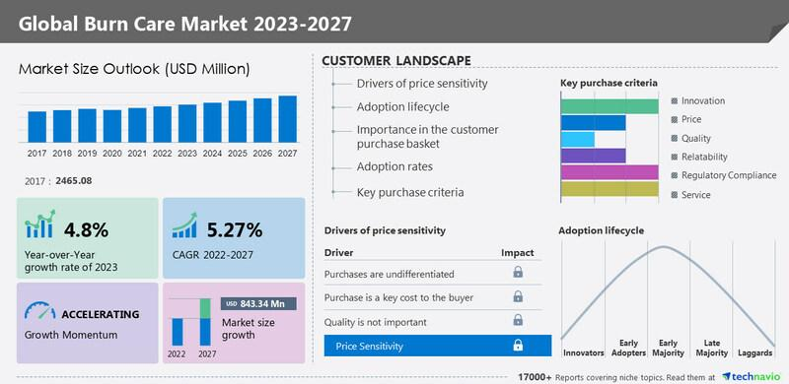
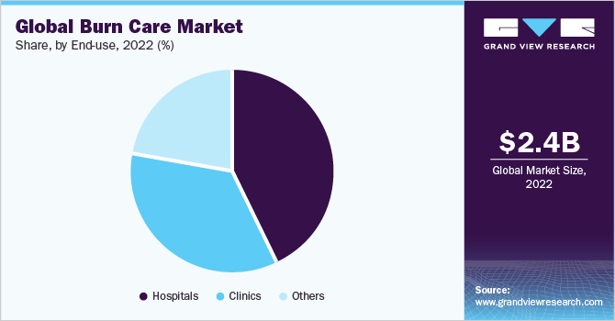
Statistics and Numbers
PART 01

Slide 5

Idea Developing
PART 01
1. Spider Silk
3. Foaming
Spider silk has shown unique potential in a wide range of wound healing applications.
For the
Better Treatment & Less pain
Foam-type products reduce pain by minimizing irritation and pressure on the affected area.
2. Mussel Protein
4. Cooling Effect
The mussel contains several anti-inflammatory compounds to treat inflammatory conditions.
Cooling effect
- by ingredients
- by presurred gas of the container

Slide 6
02
PART
Burn = Pain
Despite advances in medical technology and science, the development of emergency treatment techniques to relieve the pain of burn patients is insufficient, and traditional dressing methods are still used.
Spider Silk
Foaming Type
Less Pain
Easy Application

Slide 7
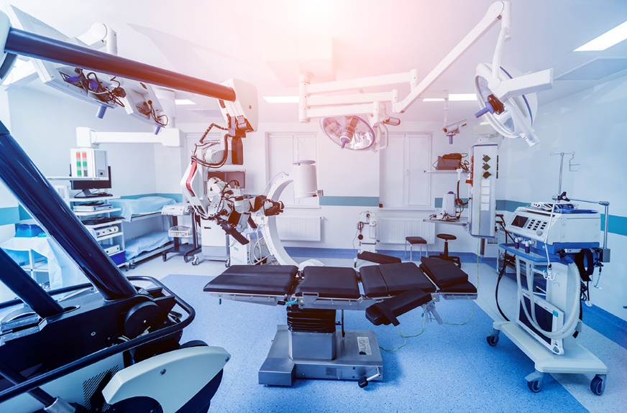
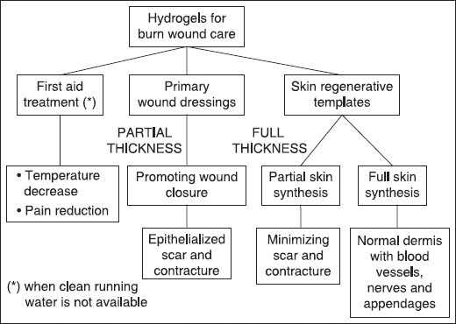

Process of Current Treatment
PART 02
Current Treatments for Burn Patients

Slide 8
Problems with Existing Treatments
PART 02
Pain of Dressing
Portability
The pain of burns is very severe. The pain spreads to the wound and its surrounding area, and conventional dressings maximize the pain.
It is not easy to carry emergency medical equipment for burns. Hence, providing immediate emergency treatment for burns on site is difficult.
Professionality / Cost
Application
Dressing a severe burn wound requires professional treatment. Treatment by specialists poses an economic burden due to patients’commuting and the medical costs.
Treatment and dressing are difficult depending on the area and area of ​​the burn wound.

Slide 9
03
PART
Solution of Our Project
Our work is a product for first aid to burn patients. This product relieves patients' pain and is characterized by easy first aid.
Spider Silk
Foaming Type
Less Pain
Easy Application

Slide 10
Uniqueness of the Project,
Solution to Existing Problem
PART 03
Spider silk, which has excellent biocompatibility, reduces the risk of infection and reduces the burden on vulnerable wounds.
Foam-type products can be easily applied to wounds, making it possible to treat patients without the help of experts at site.
Foam products can be applied evenly despite the curves of the human body. Foam is also easy to apply to large wounds.
1.Biocompatibility
2.Easy Application
3.Coverage
4.Portability
5.Reduing Pain
The product in the container can replace many medical tools for burn patients
Unlike existing gauze bandages or patches that attach to the skin, the foam reduces skin contact and reduces pain.

Slide 11


Advantage: Biocompatibility - Spider Silk
PART 03
- Biocompatibility
- Ingredients derived
from spider silk
- Spide Silk
- Mussel Protein
Light, strong and has excellent elasticity.
Compatible with the human body
Few side effects
Safe as a biomaterial.
Stable Structure and Capable of minimizing infection and immune system response.
Biocompatibility is increased by using mussel protein in adhesives.

Slide 12
Advantage
PART 03
01
02
03
Easy
Application
Wide
Coverage
of Wound
Portability
Advantages of
ready-made products in bottles
One bottle can replace various tools for medical emergency.
Foam allows for easy application to the curves of the body

Slide 13
04
PART
Our Customers
Our Various Target Customers
Spider Silk
Foaming Type
Less Pain
Easy Application

Slide 14
Target Customers
PART 04
Our target customers will be nursing hospitals, children's educational institutions, military, industrial sites, burn hospitals, and NGOs.
Medicines for emergency situations at home
Easy to treat and carry in emergency situations
Easy to use in places with poor medical environments
Prepare for emergencies that may occur in children
Rapid treatment for patients with limited mobility
House hold
Reduces the effort of medical staff
Military
NGO (ex. MSF)
Education Institute
Nursing
Hospitals
Hospital

Slide 15
05
PART
Misc.
This chapter mentions the product price structure and management indicators of our work. We briefly introduce the present and future of the market.
Spider Silk
Foaming Type
Less Pain
Easy Application

Slide 16
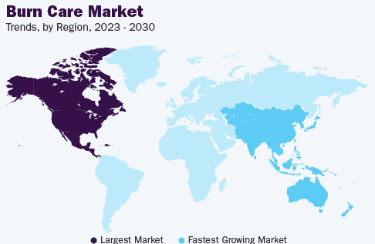
Current Market
PART 05
$2.43Bn
Huge and still growing market
The global burn care market size was valued at USD 2.43 billion in 2022 and is projected to grow at a compound annual growth rate (CAGR) of 7.15% from 2023 to 2030.
Target Market
Regional Bias
Still Growing
The half of this market is focused on“dressing” which will be the target market of our product.
North America takes 51.8% of the market and other regions are growing even in faster speed.
The CAGR of this market is expected 7.15%. This number will also growing.
Notes:
https://www.grandviewresearch.com/industry-analysis/burn-care-market

Slide 17
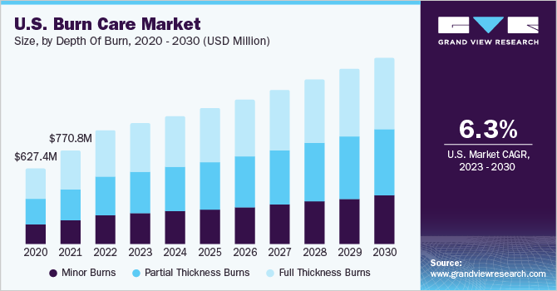
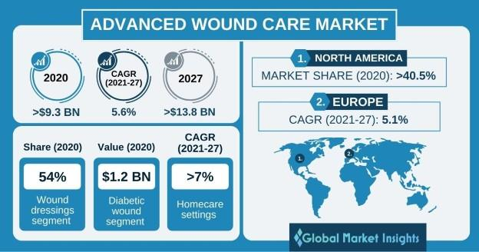
Current Market
PART 05
7.15%
Global Annual Growth
Burn Care Market is one of the Fastest Growing Market in Medical Industry
U.S Annual Growth of the Market
54% of
Market Share
Market Share of the Burn Care Wound Dressing takes
54% of all Wound Dressing Segment.

Slide 18
Cost Structure
PART 05
Significant Cost
Product R&D, Engineer Design for Container
R&D
Fixed/Flexible
Spider Silk, Manufacturing cost, Advertisement Cost, Salary, Rent, Maintenance
Business
Expenses
Profit
Manufacturing
Spider Silk
Average Industries Profit is 7-9%

Slide 19
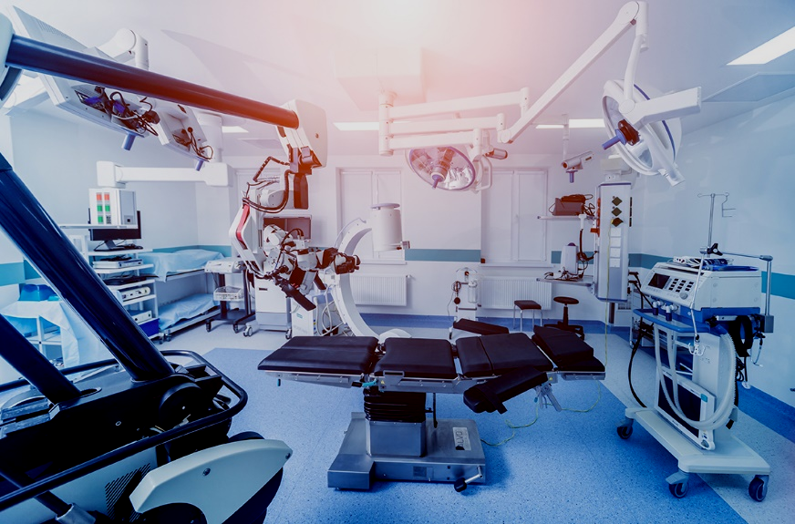


Misc. Figures / Future of the Market
PART 05
Biggest Burn Care Market , America
North America dominated the burn care market and accounted for the largest revenue share of around 51.8% in 2022, owing to the increasing incidence of burns. According to a 2018 report by the American Burn Association, over 300 children are treated in emergency rooms in the United States each day, with roughly two children dying from burn injuries. In the U.S., children aged 16 and under account for roughly 26% of all burn center admissions. In addition, the National Center for Biotechnology Information (NCBI) estimates that 486,000 individuals are injured by fire each year. Thereby, burn care products are anticipated to be in high demand because of a high rate of burns.
Future of the Market, Radiation Burn / Chemical Burn
Thermal burns are the most common. The thermal burns segment accounted for the largest revenue share of 74.9% in 2022 owing to a high incidence of fire-related burn injuries.
However, in the future, our work can be released by expanding the product line to cover chemicals or radioactivity.

Slide 20
CONRAD
CHALLENGE
2024
Conrad
Challenge

